Slide 1
Bank Marketing Data Set
Prepared by
Vikram Bahadur
and
Ilya Shnip

Slide 2
The idea of the project
The primary objective of this project is to develop a predictive model that can accurately anticipate whether a client is likely to subscribe to the bank term deposit ('yes') or not ('no'). By leveraging various features such as client demographics, past interaction history, and campaign-specific details, the model aims to identify patterns and factors that influence the subscription outcome.
Through the successful completion of this machine learning project, the banking institution can enhance the efficiency of its direct marketing campaigns by targeting clients more likely to subscribe to term deposits, ultimately improving the overall effectiveness of their marketing strategy.
Predict if the client will subscribe a term deposit (variable y).

Slide 3
What’s inside of our data set
Client’s data
The last marketing campaign
Social and Economy context
Other’s
age (numeric)
job : type of job (categorical)
marital : marital status (categorical)
education (categorical)
default: has credit in default? (categorical)
housing: has housing loan? (categorical)
loan: has personal loan? (categorical)

Slide 4
What’s inside of our data set
Client’s data
The last marketing campaign
Social and Economy context
Other’s
contact: contact communication type (categorical)
month: last contact month of year (categorical)
day_of_week: last contact day of the week (categorical)
duration: last contact duration, in seconds (numeric)

Slide 5
What’s inside of our data set
Client’s data
The last marketing campaign
Social and Economy context
Other’s
emp.var.rate: employment variation rate - quarterly indicator (numeric)
cons.price.idx: consumer price index - monthly indicator (numeric)
cons.conf.idx: consumer confidence index - monthly indicator (numeric)
euribor3m: euribor 3 month rate - daily indicator (numeric)
nr.employed: number of employees - quarterly indicator (numeric)

Slide 6
What’s inside of our data set
Client’s data
The last marketing campaign
Social and Economy context
Other’s
campaign: number of contacts performed during this campaign and for this client (numeric, includes last contact)
pdays: number of days that passed by after the client was last contacted from a previous campaign (numeric; 999 means client was not previously contacted)
previous: number of contacts performed before this campaign and for this client (numeric)
poutcome: outcome of the previous marketing campaign (categorical)

Slide 7
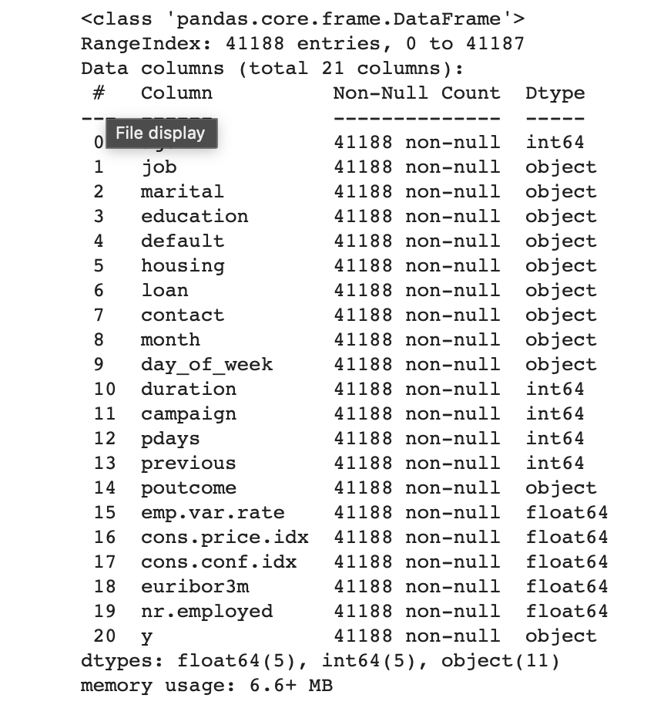
Data preparation & Features Engineering
Checking for null’s

Slide 8
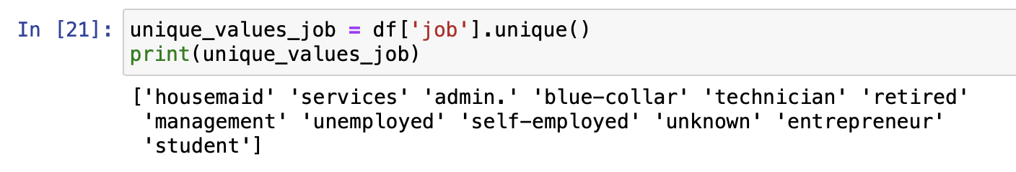
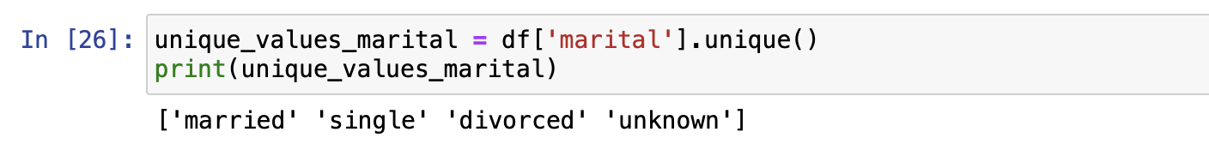
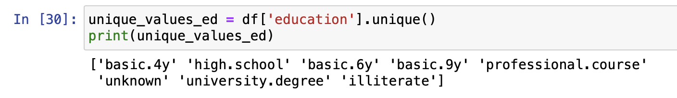
Data preparation & Features Engineering
Is it really no nulls in the data set?
Despite the last report, that showed us that there is no missing data in our data set. We have found out, that some data are missing.
In total there are 2 943 rows, with ‘unknow’ variables. It is less than 1% of the whole data set.
Spoiler – we have tried to delete this data. But it didn’t affect much our models. So, for the final version, we have keep all ‘unknow’ variables.

Slide 9

Data preparation & Features Engineering
First lesson that we learned
Never trust the machine!

Slide 10
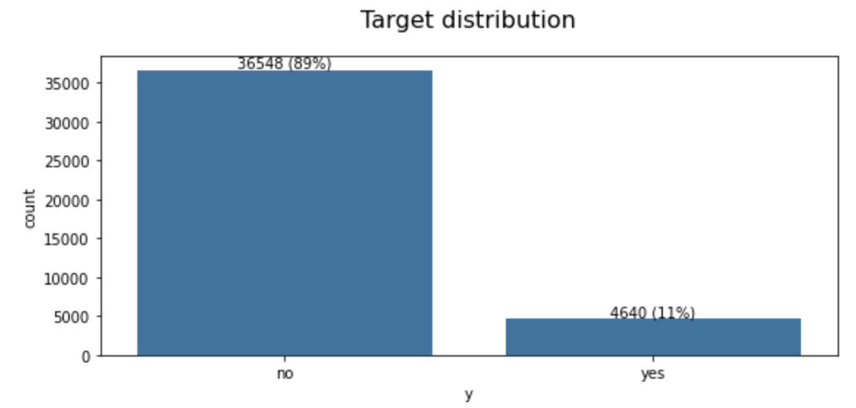
Data preparation & Features Engineering
We have found a problem. Our data set is unbalanced.
The number of "yes" answers is small. Almost 8 times smaller than number of answers "no".
Such great difference would cause a problems.

Slide 11
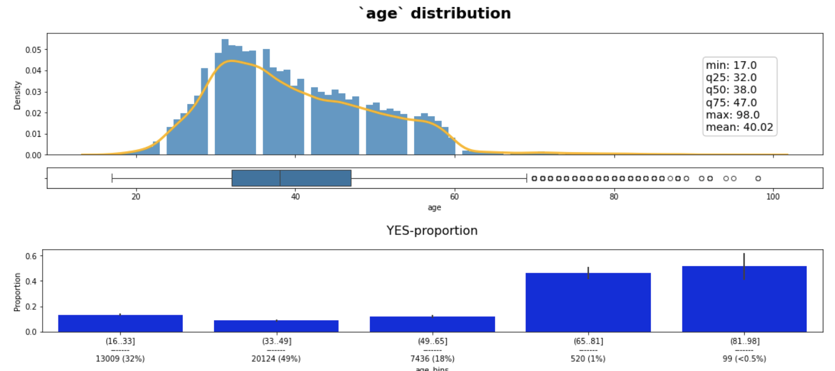
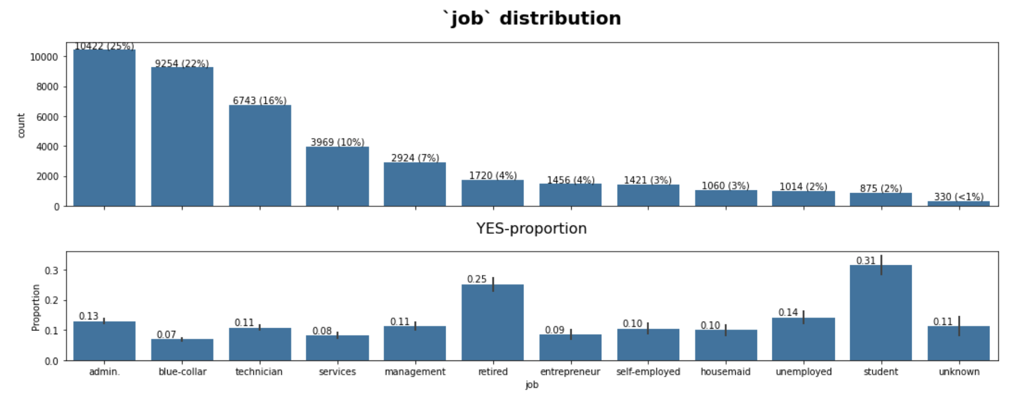
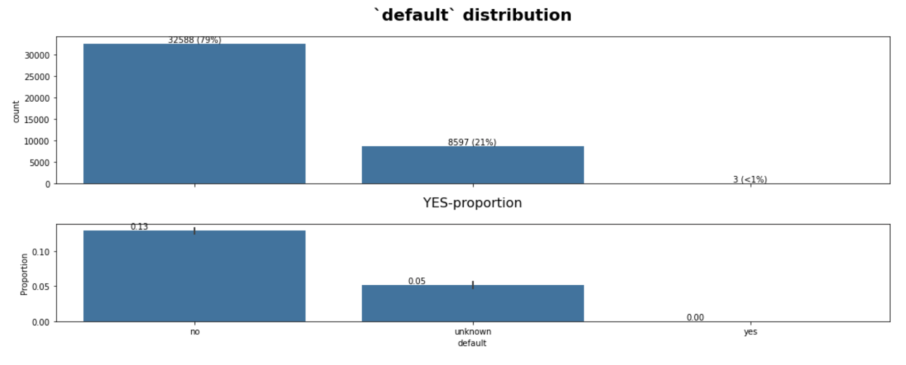
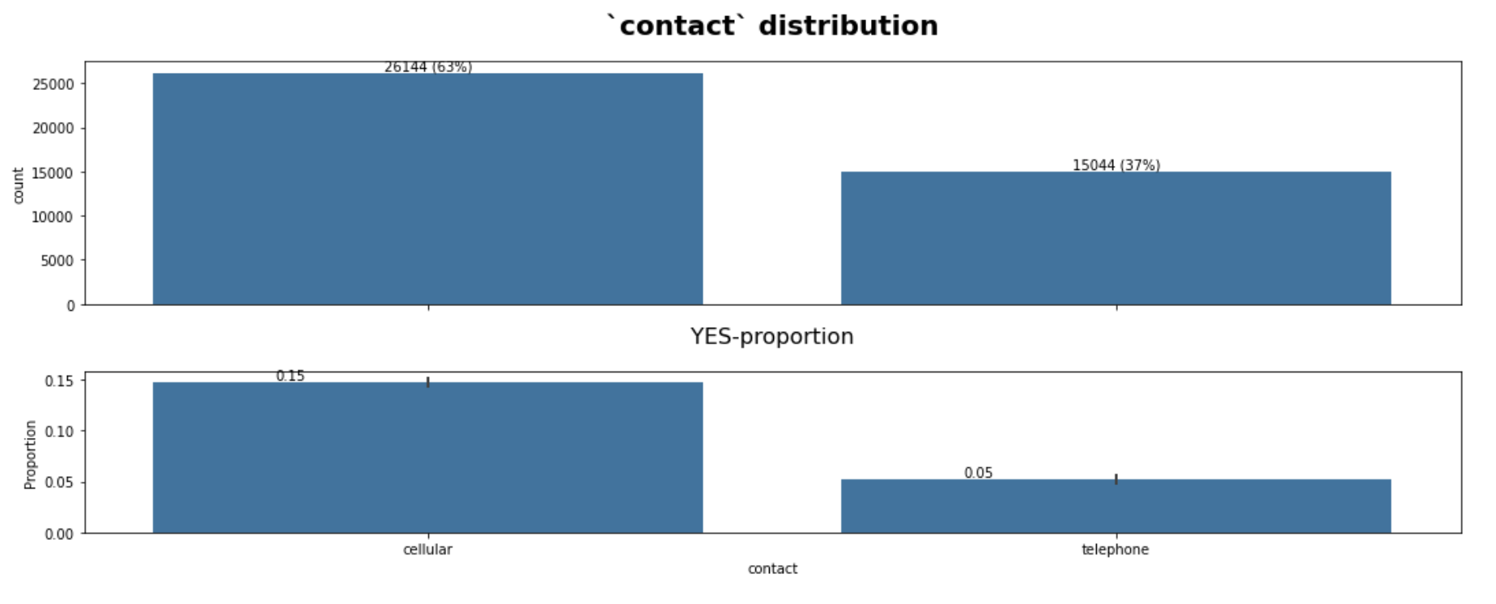
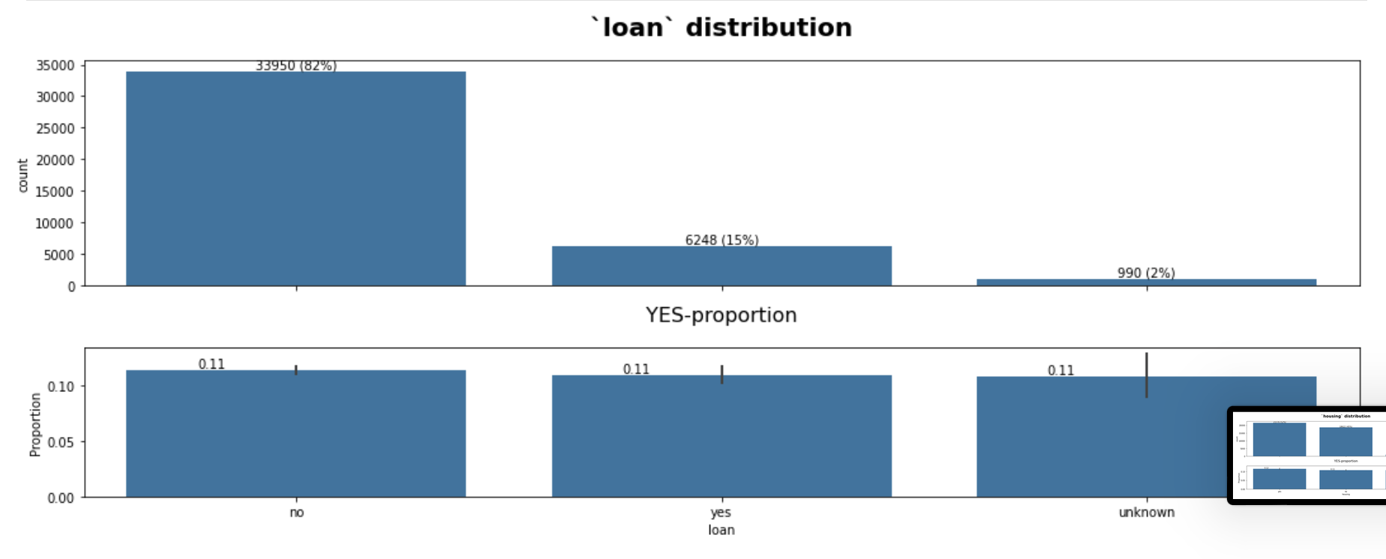
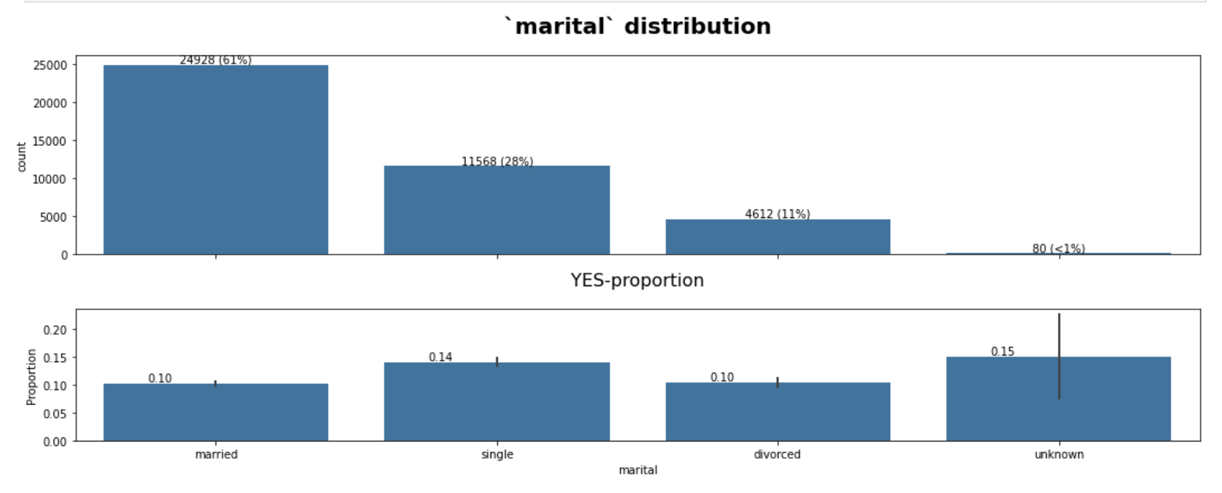
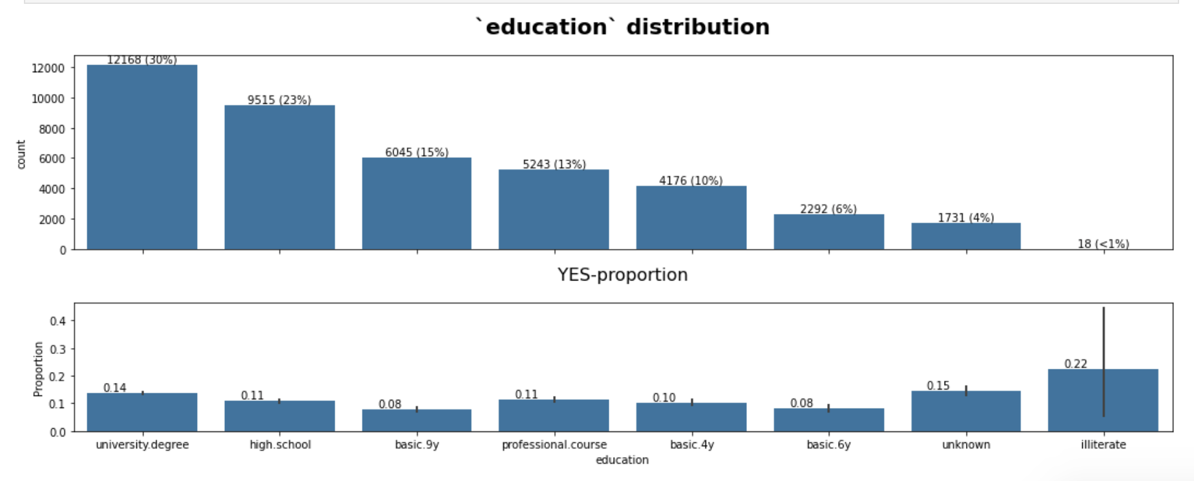
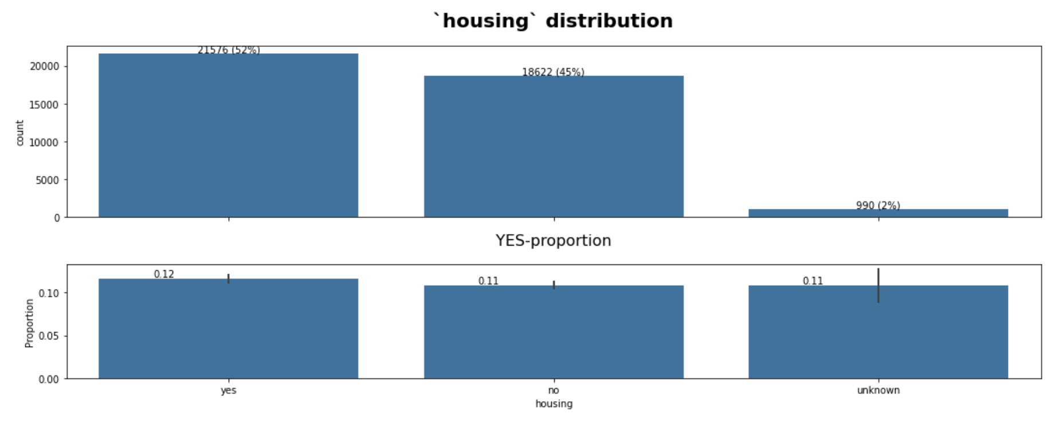
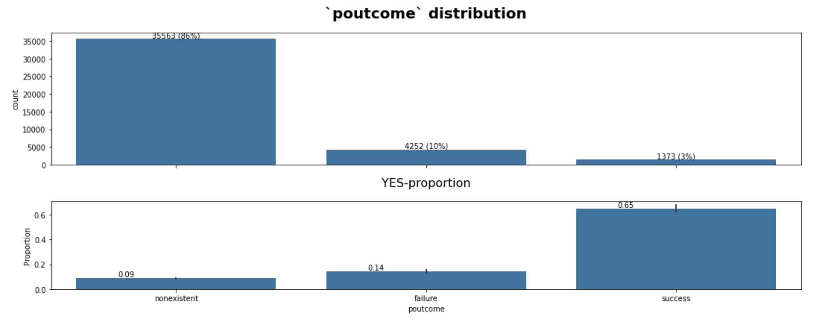
Data preparation & Features Engineering
Categorical features - graphs

Slide 12
Data preparation & Features Engineering
Interesting observations
Interesting observation no.1 - people with NO credit in default are more likely to agree to subscribe a bank term deposit
Interesting observation no.2 - people which were contacted via cellular are a bit likely to agree to subscribe a bank term deposit.

Slide 13
Data preparation & Features Engineering
Summary
Most of the categorical features does not correlate with out target variable.
Except such variables as: default and contact.

Slide 14
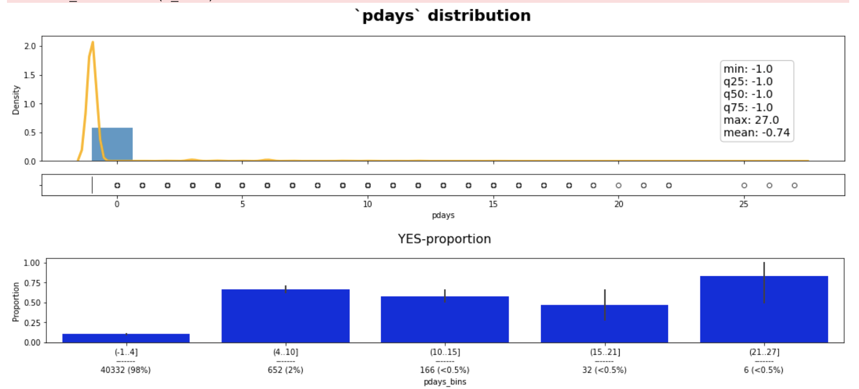
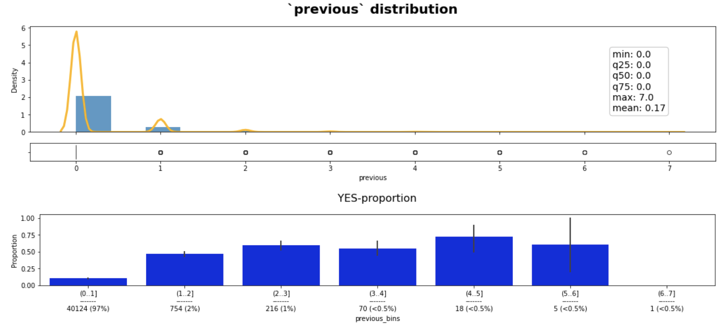
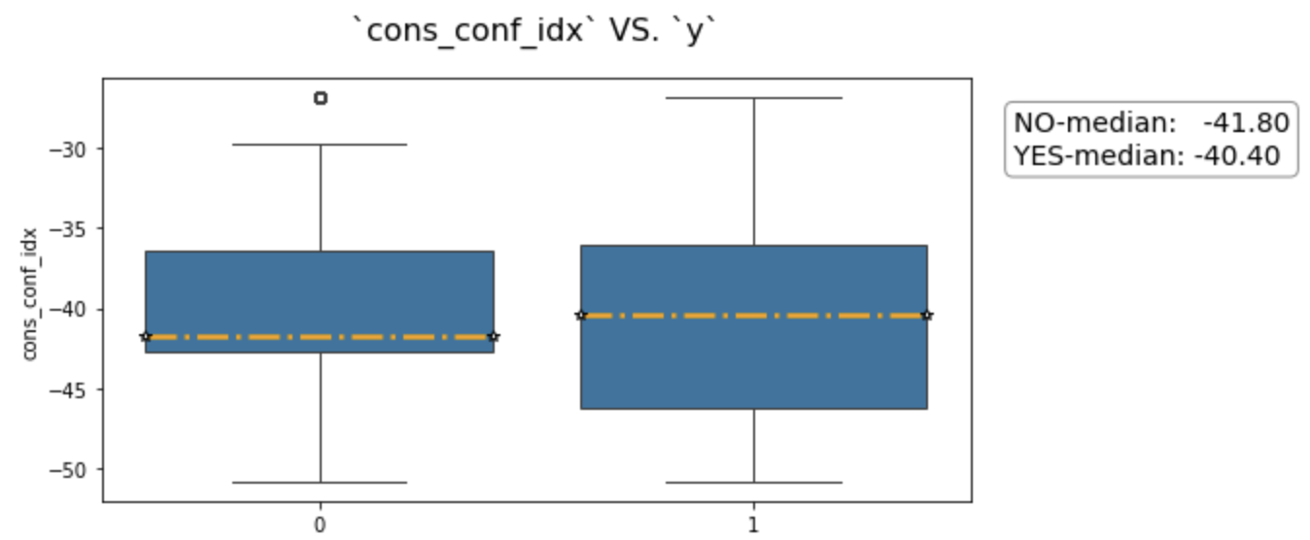
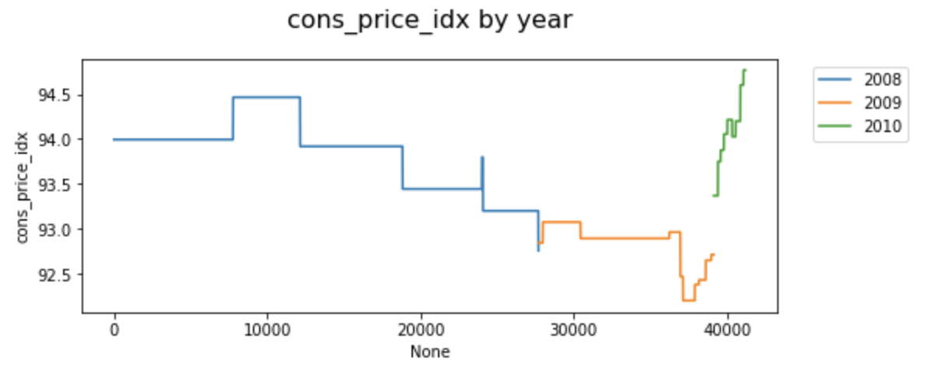
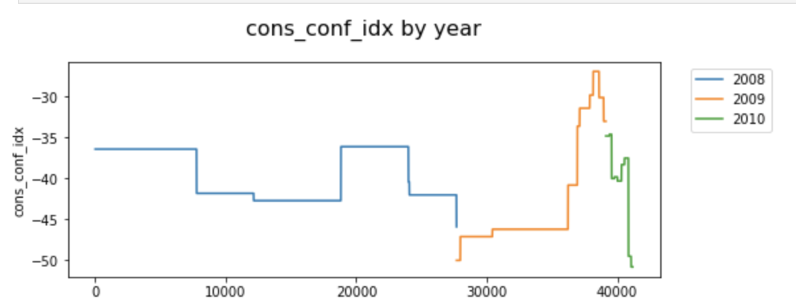
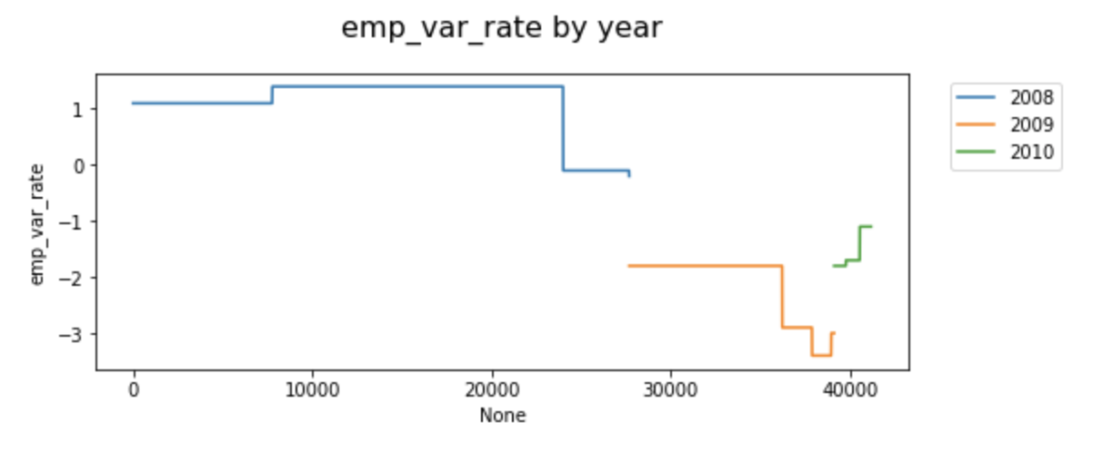
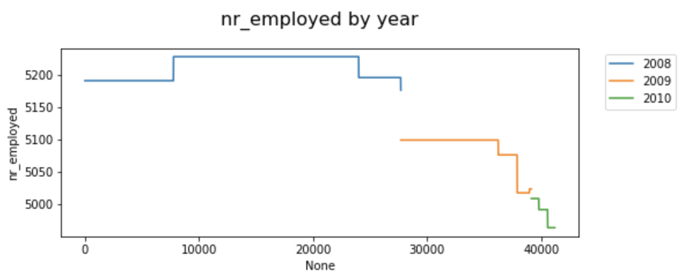
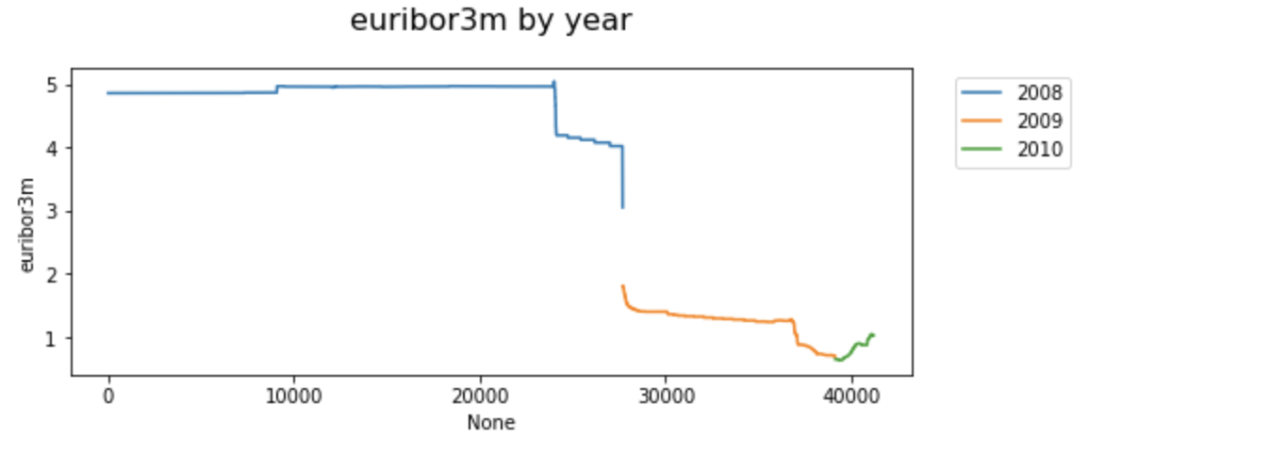
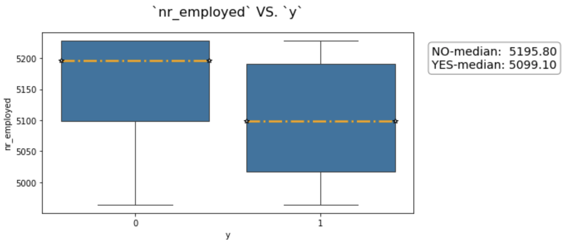
Data preparation & Features Engineering
Numerical features

Slide 15
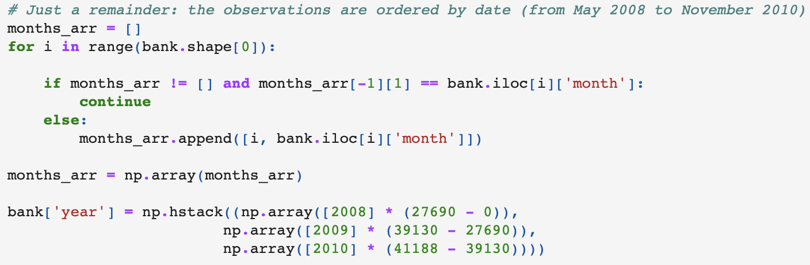
Data preparation & Features Engineering
Important note
For the exploration of the numeric features we have decided to add “year”.
We know, that our data set was collected from May 2008 to November 2010

Slide 16
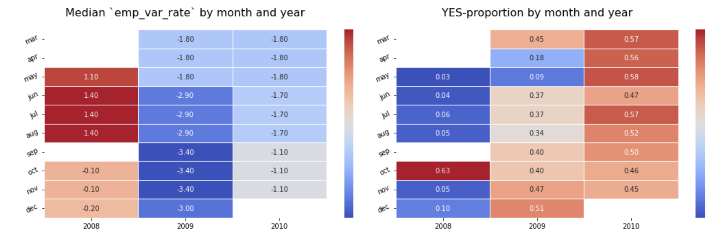
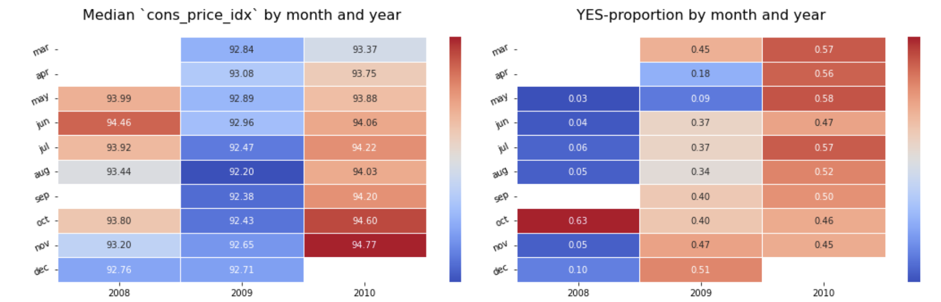
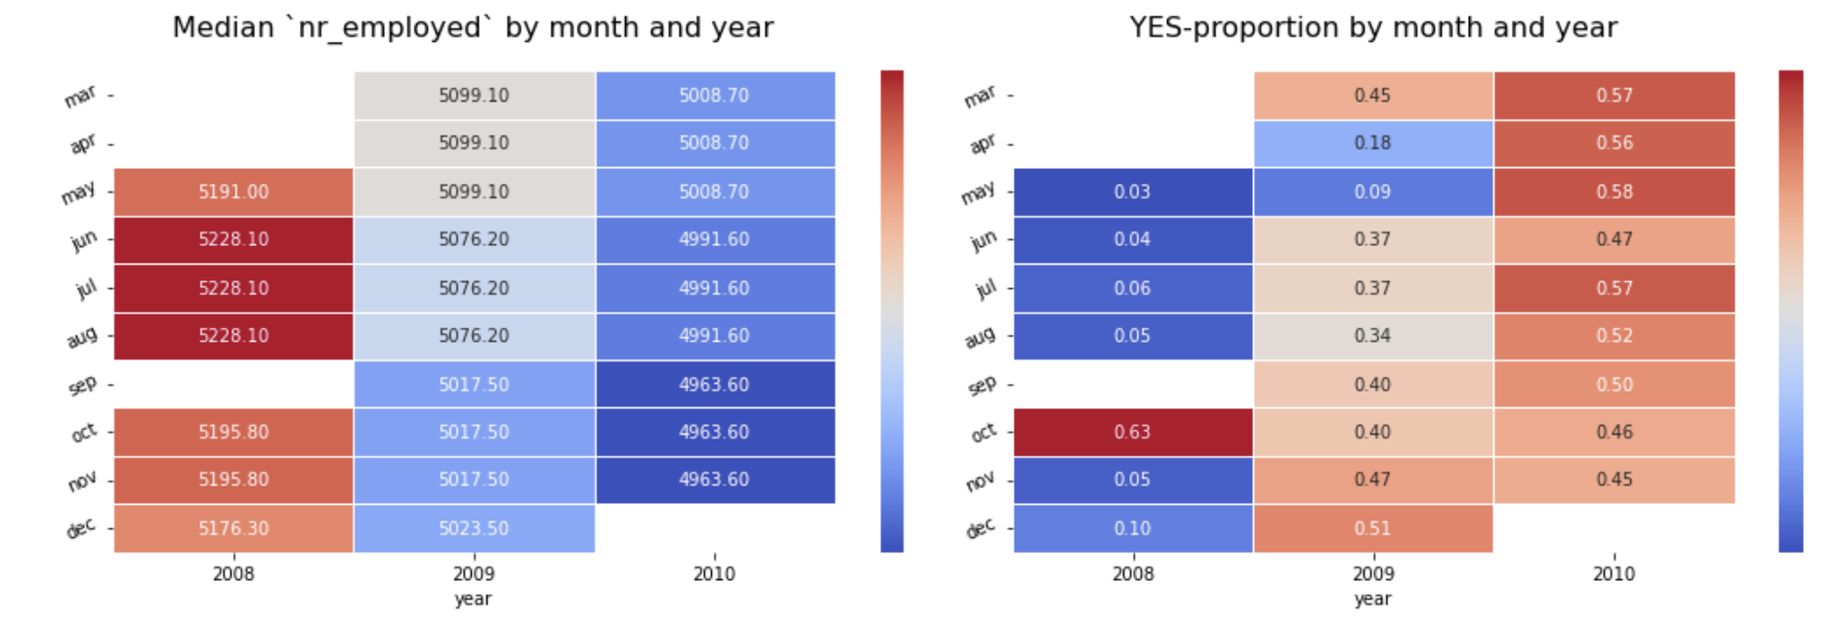
Data preparation & Features Engineering
Interesting observations
We have found out that such variables as: emp_var_rate, cons_price_idx, nr_employed and euribor3m have negative correlation with target variable.
For example: the higher employment variation rate - the lower YES-proportion.

Slide 17
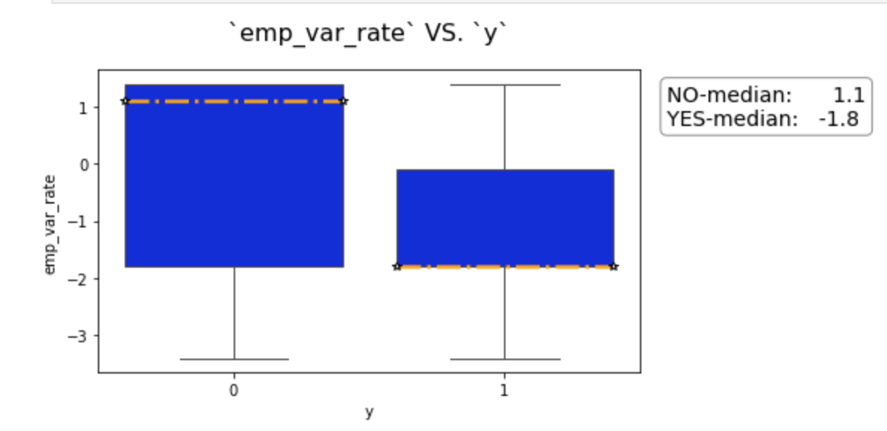
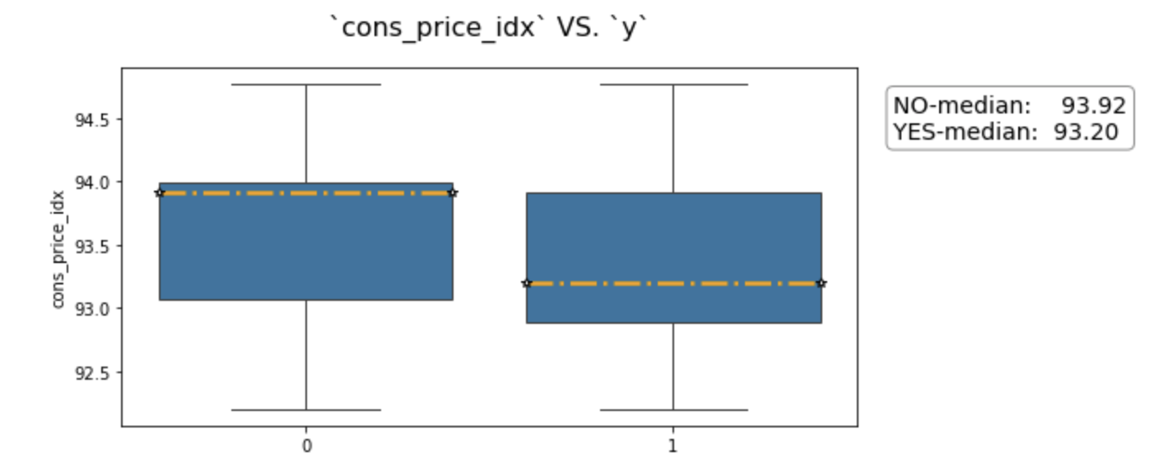
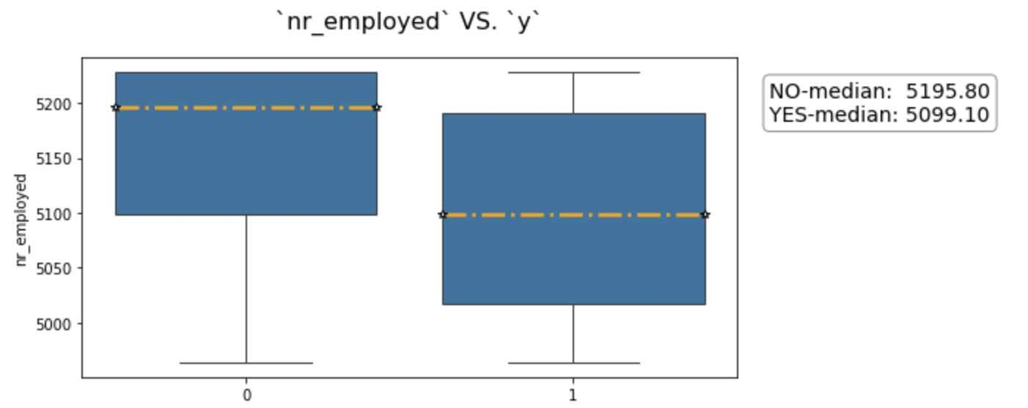
Data preparation & Features Engineering
Correlation of the numerical
Because of the difference between medians, such features as emp_var_rate, cons_prices_idx and nr_employed can be usefull for the classification.

Slide 18
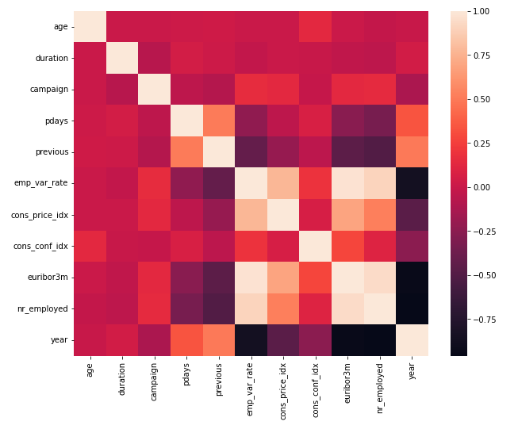
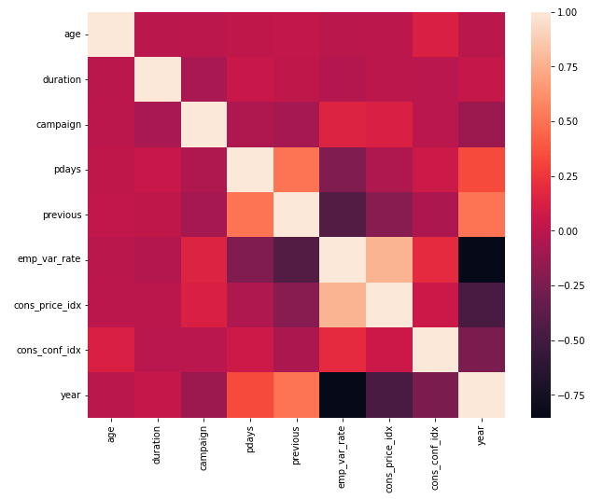
Data preparation & Features Engineering
Selecting of features
Removed the features having more than .9 correlation
duration column is not known before a call is performed. Also, after the end of the call y is obviously known. Thus, this input should only be included for benchmark purposes and should be discarded if the intention is to have a realistic predictive model.

Slide 19
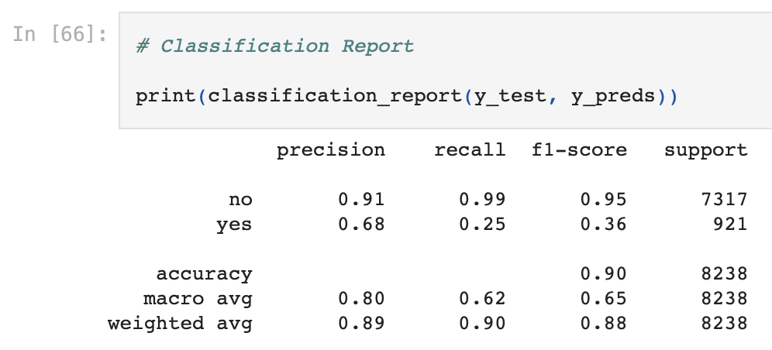
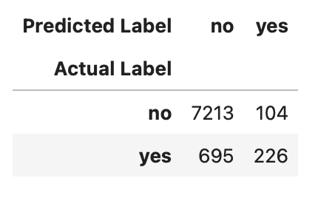
Models
Logistic Regression
Logistic Regression – Base Model
The problem of unbalanced data set, we have a high precision for ’no’ and low precision for ‘yes’

Slide 20
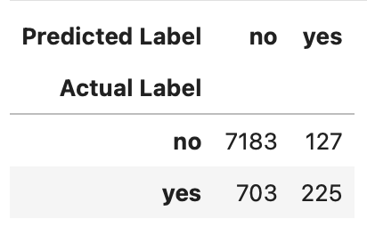
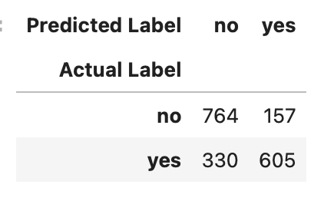
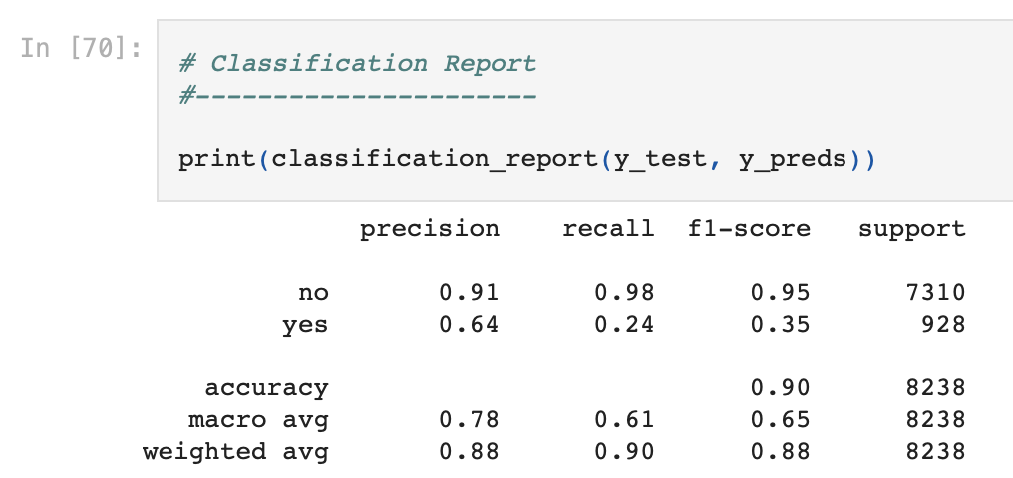
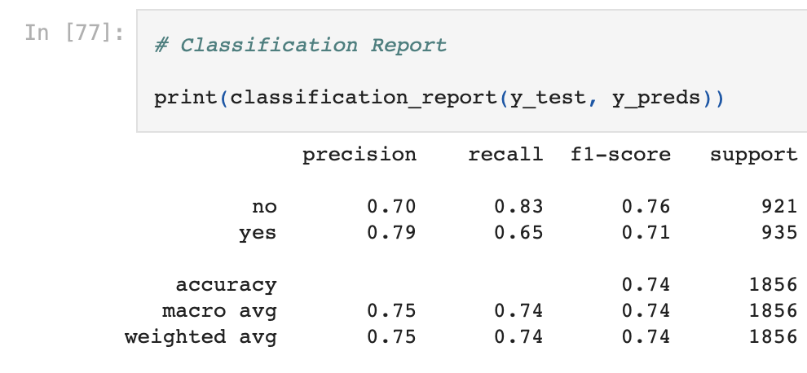
Models
Logistic Regression
Logistic Regression – trying to balance the data set with stratify
Logistic Regression – trying to shuffle and resample data set

Slide 21
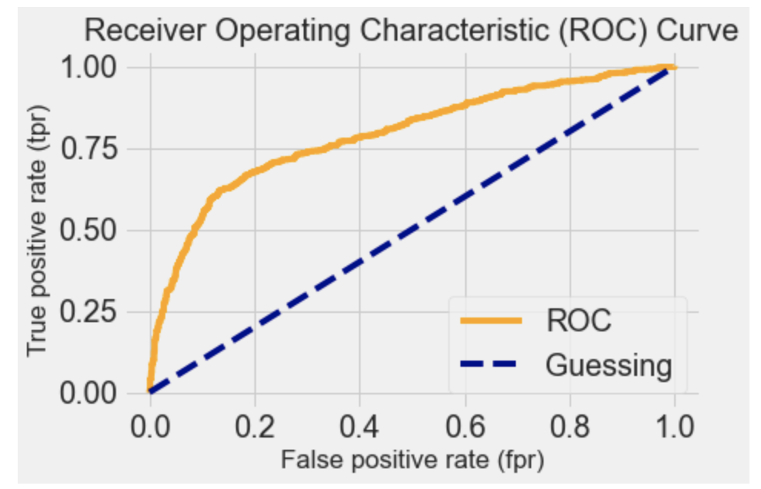
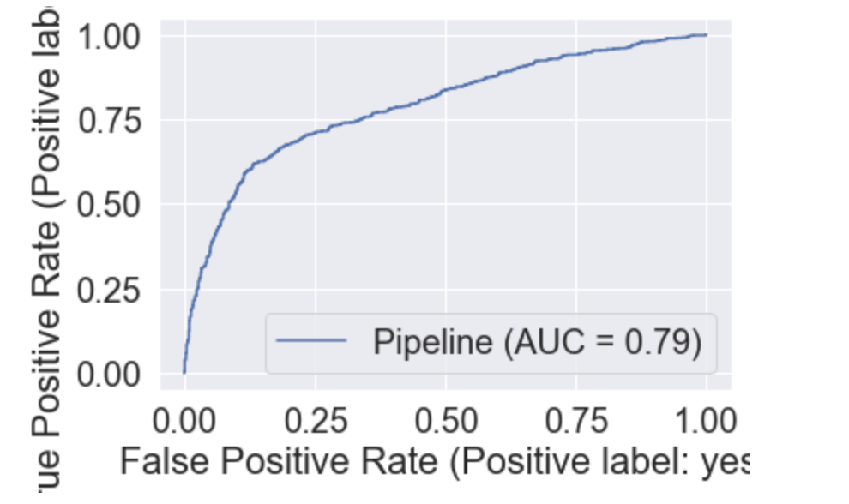
Models
Logistic Regression

Slide 22
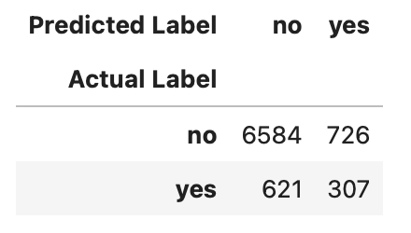
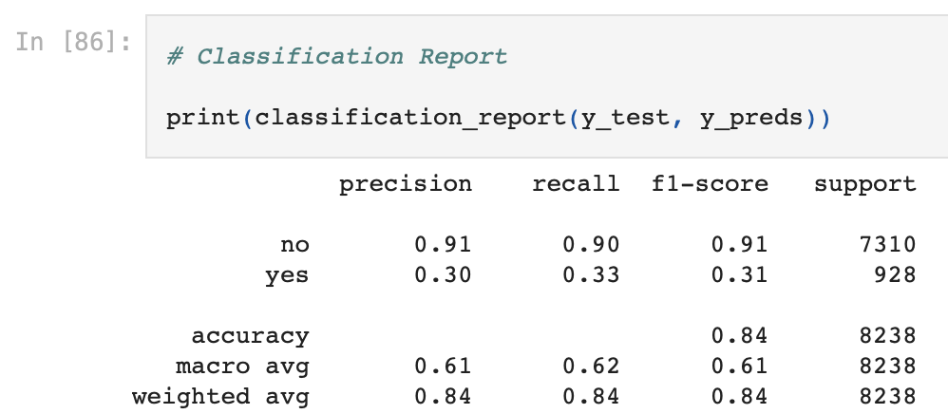
Models
Decision tree
Look like a decision tree handling with unbalanced data set even worse, than base logistic regression

Slide 23
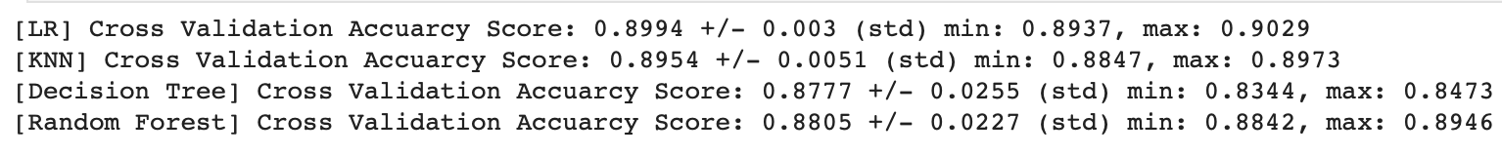
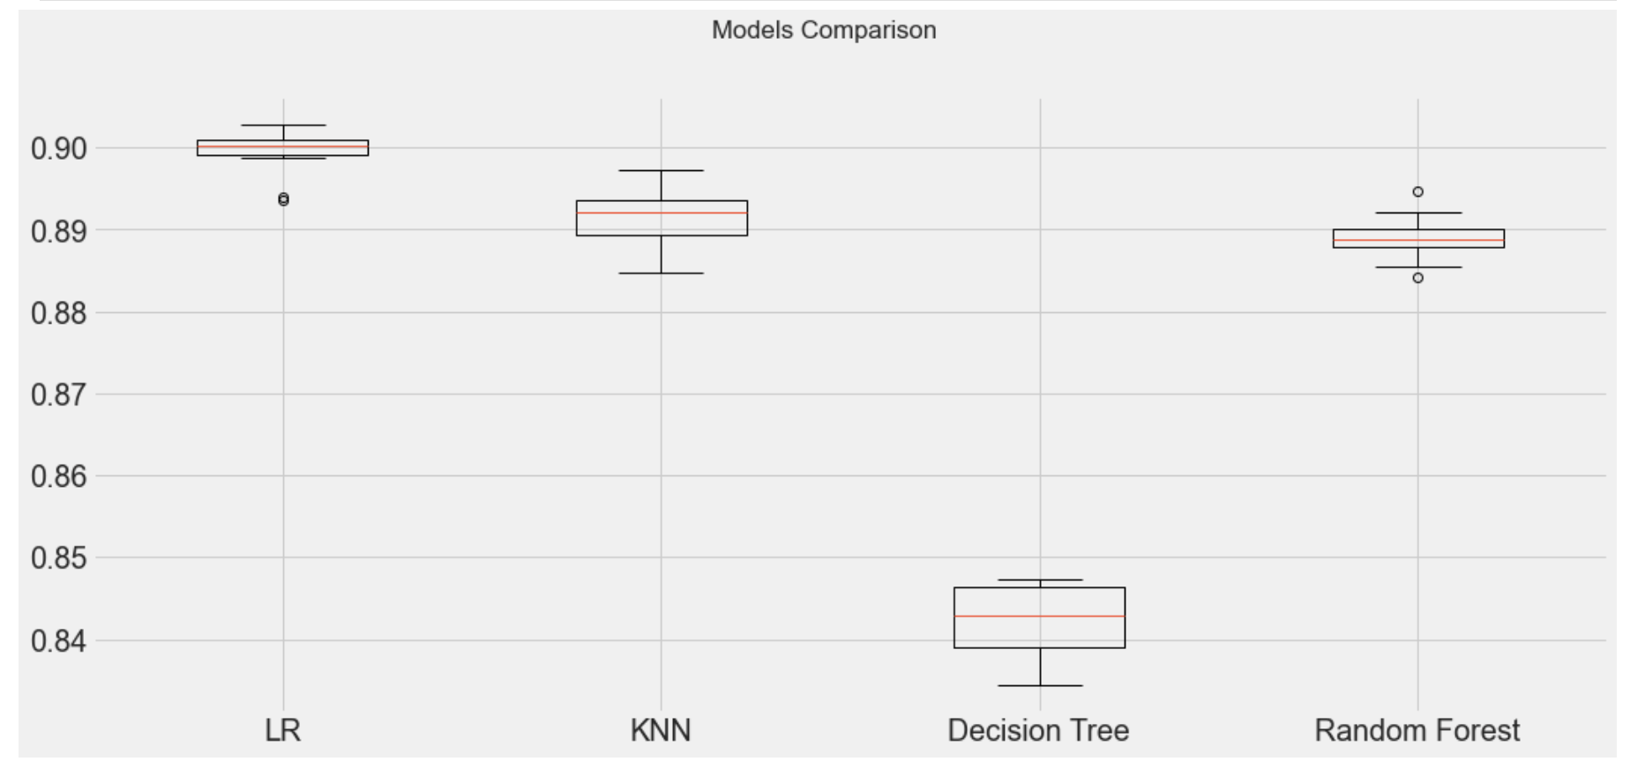
Models
Results
Conclusion
Logistic Regression seems to be the best model, further need to optimize the parameter space to find the best hyperparameters and model.

